Slide 1

Growth and Development of the Toddler: 1 to 3 Years
Early Childhood
Third Stage
Dr. Moustafa Alshammari
Growth and Developments

Slide 2
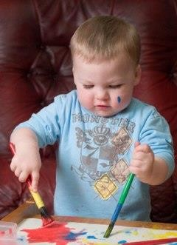
Growth and Development of the Toddler: 1 to 3 Years
1

Slide 3
Objectives:
Identify the gross motor development in the toddler.
Recognize the fine motor development in the toddler.
Recognize the language skill development in the toddler.
Explain the psycho-social development in the toddler.
‹#›

Slide 4
Cont. objectives
Explain the cognitive development in the toddler child
Identify the health promotion and health maintenance of the toddler
Recognize the health problems in the toddler age period and the nurse's roles/actions in dealing with the toddler
‹#›

Slide 5
Normal Toddler (1 to 3 years)
Normal toddler: (1 to 3 years of age).
During this period, growth slows
considerably.
During these years, children begin the long process toward independence.
Toddler develops from having no voluntary control to being able both, to walk and speak.
They also learn to control their bladder and bowels, and they acquire all kinds of information about their environment.
Gaining self-control mastering tasks such as walking, jumping, dressing, and eating, and learning to use language to express needs.
‹#›

Slide 6
Physical Development of the Toddler
Time of slowed growth and rapid development
Learns to chew food with continued eruption of teeth
Masters tasks such as walking, jumping, dressing, eating, use language to express needs
Learns to stand alone and walk between 1 and 2 years
Most toddlers say their first words and refine language skills
By end of this period, may be toilet trained
‹#›

Slide 7
Physical Growth:
Average weight gain is 1.8 to 2.7 Kg/year. Formula to calculate normal weight of children over 1 years of age:
(Age in years x 2) + 8 = ---- Kg)
E.g. 2 years old child weight = 2 x 2 + 8 = 12 Kg.
*Toddlers are usually chubby, with relatively short legs and large head. The face appears small when compared to the skull, but as the toddler grows. These proportions gradually change to that of the adult size.
‹#›

Slide 8
Height:
It increases about 10 to 12.5 cm/year.1-2 years increases 1 cm /month.
Formula to calculate normal height of children over 1 year of age:
(Age in years x 5 + 80 = -----cm)
E.g. length of 2 years old child = (2 x 5)+ 80 = 90 cm.
‹#›

Slide 9
Head and Chest Circumferences:
From 1 year to adult the head increases 10 cm only.
During toddler years, chest circumference continues to increase in size and exceeds head circumference.
Anterior fontanel closes between 12 - 18 months of age.
‹#›

Slide 10
Teething:
By 2 years primary dentition of 16 teeth and 20 teeth by 30 months (2 1/2 years).
Abdomen:
It is a protruded and toddler appears pot- belled because of the immature abdominal musculature. Abdomen flattening results from development of abdominal muscles.
Bow-legs typically persist along toddlerhood since they must bear the weight of the large trunk.
10

Slide 11
Bowel and bladder control:
Daytime control of bladder and bowel control by 24 - 30 months.
Senses:
Visual acuity of 6/6 is achieved during this period.
Senses of smell, hearing, touch, and taste increasingly well developed.
Accommodation well developed.

Slide 12
Physiological Growth:
* Pulse: 80-130 beats / minute (average 110 / min)
* Respiration: 20-30 breath / min.
*Blood pressure: Systolic 95-105mm Hg Diastolic 53-66 mm Hg

Slide 13
Motor Development:
Age in Gross Motor Fine Motor month
₁₅th
Walks alone
Creeps upstairs
Assumes standing position without support
Can not throw ball without falling
Builds tower of 2-3 blocks.
Open boxes.
Holds a cup with all fingers grasped about it
Make line with crayon.
Scribbles spontaneously

Slide 14
18th
months
Run clumsily (often
falls).
Build a tower of 3 to
4 blocks.
Walks backward and
sideways.
Walks upstairs with one hand held.
Jumps in place with both feet.
Throws ball overhand without falling.
Climbs on furniture.
Seats self on chair
Removes simple
clothes, e.g. shoes.
Hold cup with both hands.
Imitates a vertical line.
Eats with spoon, turns spoon in mouth but spills frequently
May play with food

Slide 15
24th months
Runs well.
Goes up and down
stairs alone with two
feet on each step.
Builds a tower of 6 to 7 blocks.
Holds cup with one hand.
Can walk with heel-toe
gait
Jumps crudely with both feet in place.
Kicks large ball
without falling
Opens the door by
turning doorknob.
Imitates circle and
horizontal stroke.
Unscrews lid of a jar.
Removes most of own clothes.
Drinks well from
small glass held in one hand.

Slide 16
30th |  | Jumps from chair or step. | Builds a tower of 8 blocks. Drinks without
mo | nths
 |  | Stands on one foot alone momentarily. Walks up and down stairs, one foot on a step | assistance. Good hand-finger coordination, therefore, holds crayon with finger rather than fist

Slide 17
Language Development:
₁₅th
month: Says 4 to 6 words (mainly
■
names).
₁₈th
month: Says 10 words or more.
■
24th month: Vocabulary of almost 300 words. Uses 2-3 word phrases sentence.
30th month: Talks constantly. Uses plurals and names one color.
And gives first and last name.

Slide 18
Emotional Development:
Tolerates to some extent separation from parent, but he develops separation anxiety (anxiety develop when he is separated from the caregivers-mother).
Less fear to strangers (places and people)
Beginning to imitate parents.
Expresses emotions has temper-tantrums.
Beginning awareness of ownership (my-toy).

Slide 19
The types of play toddler engage in can be described as:
Parallel plays: the child sits with other children but does not cooperate or interact with them.
Much of playtime is imitation of role models
The toddler does not share toys until later of the toddler years

Slide 20

Parallel play
20

Slide 21
Psychosexual development:
According to Freud, the age 2-3 years represent the anal phase of development which is characterized by:
Negativism
Emotions expressed very strongly
Temper tantrums

Slide 22
Psychosocial development
According to Erickson, toddlers are working on the developmental task of autonomy versus shame and doubt.
The favorite word of most toddlers is “NO”. just saying the word seems to command the attention of those around themselves.
When the central development task is autonomy versus sham& doubt (I can do it my self) increasing abilities to control their bodies themselves, and their environment.

Slide 23
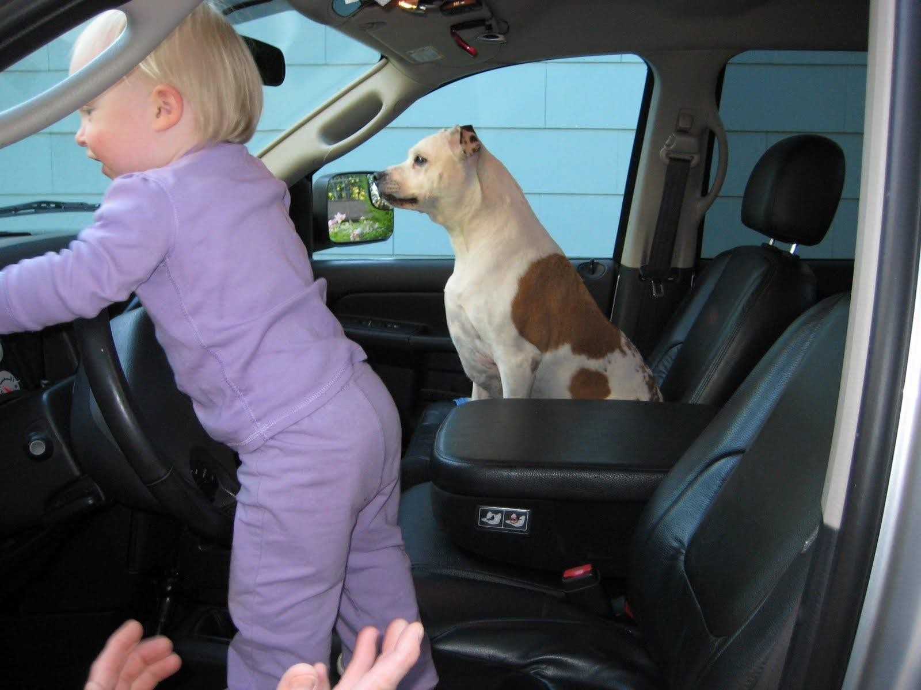

Slide 24
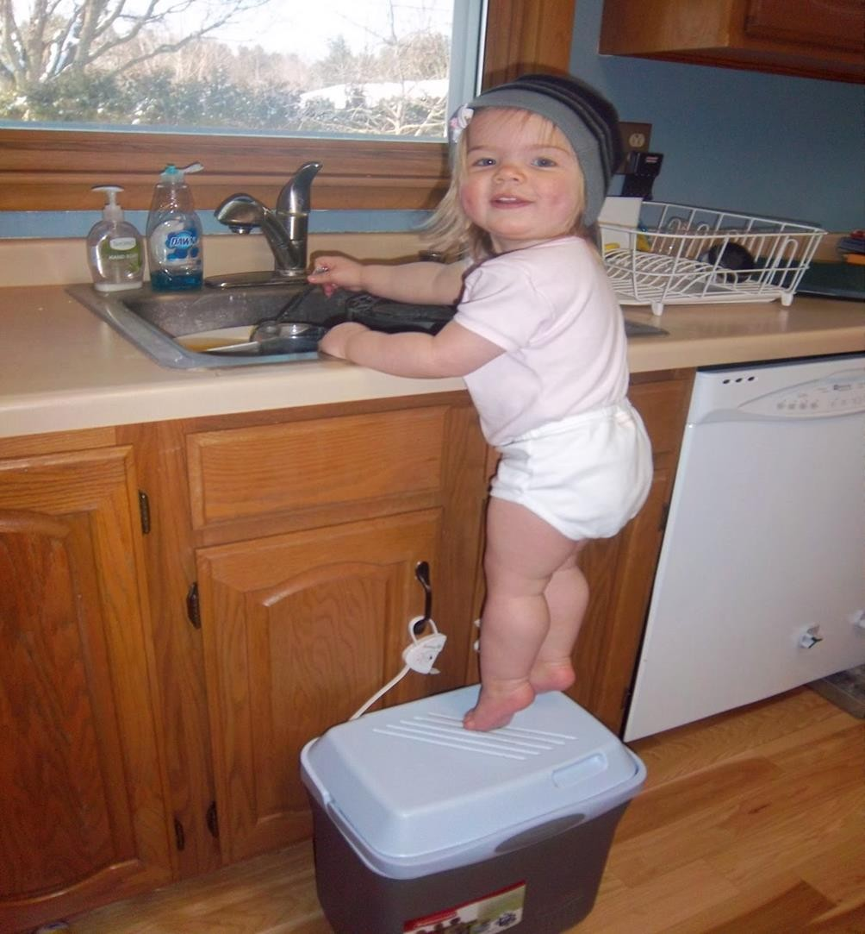

Slide 25
Health promotion & protection
Immunizations Injury prevention
Sleeping pattern
Nutrition requirement: need 100 kcal/kg/24hrs.
They prefer to feed themselves, so they can be at risk of aspiration of small foods that are not easily chewed.
Encourage self-feeding
Do not push the child to eat
Allow others to eat with the child
Offer familiar foods
Provide fluids in small but frequent amounts

Slide 26
Common Health & Developmental Problems of the toddler:
1. Stranger anxiety.
2. Stressful reaction to hospitalization.
3. Fear. (Large animals, going to sleep, loud noises, loss of parents)
4. Ritualistic behaviors (the same rituals at time of bathing, eating, sleeping)
5. Dental caries.
6. Discipline.
7. Child abuse

Slide 27
8. Toilet training (is one of several critical training situations)
9. Accidents:
  Automobile accidents.
  Burns.
  Falls.
  Poisoning. (e.g. lead & Salicylate poisoning)
10. Infections:
Otitis media and brain abscess because the Eustachian tube (From pharynx to middle ear is straight & shorter than the adult)

Slide 28
Suggestions for Potty Training the Toddler
Use a comfortable potty chair; limit the time on the chair
Have child wash hands afterwards to instill good hygiene habits
Use “pull-up” type clothing
Allow child to observe role model using toilet
Do not flush the toilet while the child is sitting on it
Do not tease or shame the child
Do not expect perfection; lapses occur

Slide 29
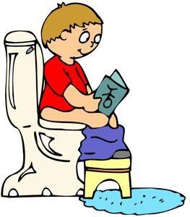
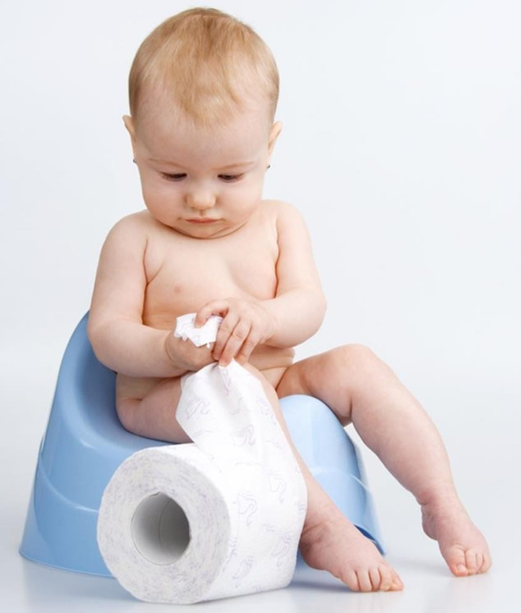
Potty Training the Toddler

Slide 30
Sleep Needs and Practices for the Toddler
Sleep needs
  1 year: 12 to 14 hours; by 3 years: 10 to 12 hrs
  Gives up a morning nap; continues afternoon nap until about age of 3 years
Sleep practices
  Rituals are a common part of bedtime procedures
  Regular schedules with set bedtimes are
important
30

Slide 31
Thank you
رمز الصف
cs5jm5o

